Slide 1
CS 419: Production Rendering
The Rendering Equation
Eric Shaffer

Slide 2
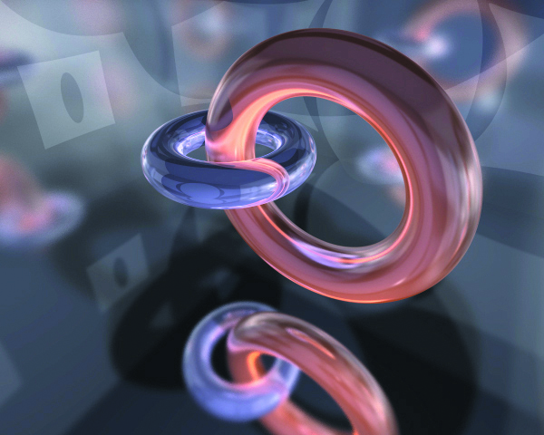
Radiometric Theory
We will look at radiometric definitions
Understand how bidriectional reflectance distribution functions (BRDFs) are defined
Understand how a perfect diffuse BRDF is implemented

Slide 3
Radiometric Theory
Radiometry deals with the measurement of radiation throughout the EM spectrum
  including visible light
Radiance is the most important quantity for ray-tracing…we’ll get to it last as we plough through some definitions

Slide 4
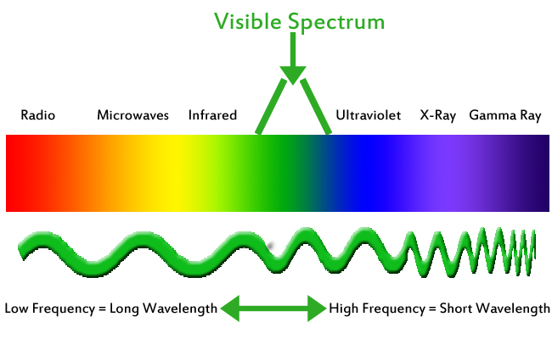
Radiant Energy
Radiant Energy Q
  Measured in joules (J)
  Radiant energy carried by a photon is Q=hc/λ
    h = 6.2620 × 10⁻³⁴ joules-seconds (Planck’s Constant)
    c = 2.998 ×10⁸ meters/second (speed of light)
    λ wavelength of the photon in meters
So shorter wavelength means what?

Slide 5
Radiant Flux
Radiant Flux Φ
  Radiant energy passing through a surface or region per second
  Measured in joules per second
  1 Watt = 1 joule/second [W]
  Also called radiant power

Slide 6
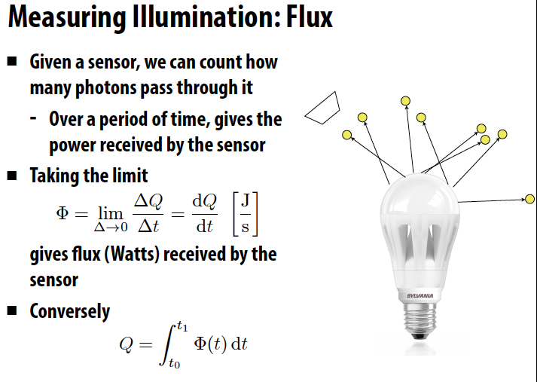
Another way of looking at Flux
Slide borrowed from Matt Pharr

Slide 7
Radiant Flux Density
Radiant Flux Density
  Radiant flux per unit of surface area
  Measured in Watts per square meter
Notes:
dA is a differential area

Slide 8
Irradiance
Irradiance
  Flux density that arrives at a surface
  Measured in watts per square meter

Slide 9
Radiant Intensity
Radiant Intensity
  Flux density per unit of solid angle
  Measured in Wm⁻²sr⁻¹
    sr⁻¹ stands for inverse steradians

Slide 10
Solid Angle and Steradians
  Solid Angle
    2D generalization of 1D angles
      Informally, It’s the size of a set of directions
    Imagine point enclosed by a sphere with radius r
      Project silhouette of an object onto sphere
      an area a = r² subtends one steradian
      ratio of area to radius squared (NOTE: different from book).
Notes:
solid angle subtended at p by object
what is the max solid angle? 4pi.
what is the unit of solid angle? It’s a dimensionless quantity. Why?

Slide 11
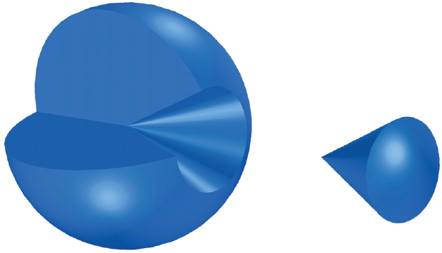
One Steradian

Slide 12
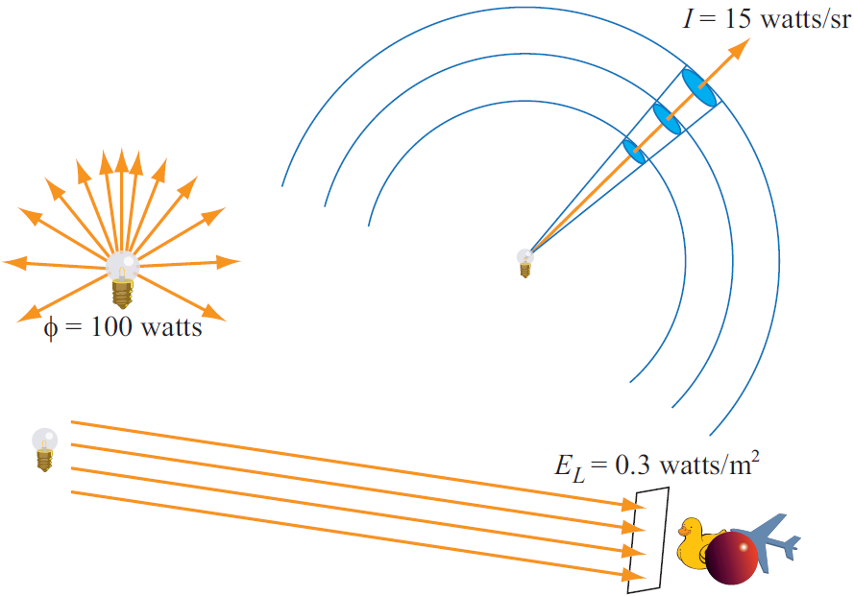
Radiometric Quantities
Notes:
E is irrADIANCE
phi is radiant flux
Intensity is flux density with respect to solid angle…watts per steradian

Slide 13
Radiance
Radiance
  flux per unit projected area per unit solid angle
  Wm⁻²sr⁻¹
  flux at point in space
    coming from a specific direction
    measured per unit area
    on imaginary surface perpendicular to the direction

Slide 14
Radiance
Radiance
  Restriction of Q in time, space, and direction
  Measures radiant flux from photons traveling down a cone dw
    In the limit, this is a single direction
Notes:
Q is radiant energy

Slide 15
Radiance
Radiance
  Constant along rays, same in both directions
  Can be defined at any point in space (not only surfaces)
  A function of five variables
    3 for a location
    2 for a direction
    …maybe a sixth for wavelength
  Rendering evaluates radiance at the eye for each direction

Slide 16
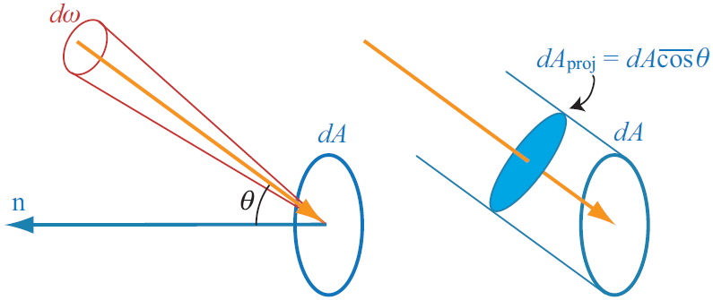
Radiance
Radiance is power per unit projected area per unit solid angle

Slide 17
Angular Dependence of Irradiance
Irradiance is proportional to the cosine of the incidence angle
Goes to 0 as light becomes parallel to surface

Slide 18
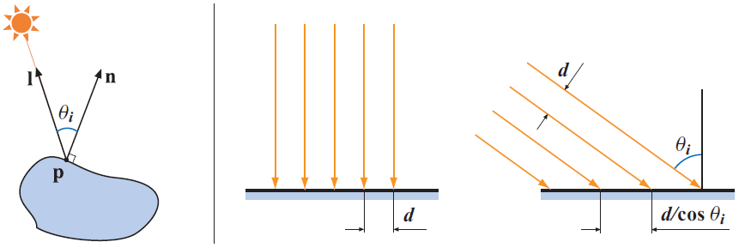
Irradiance
Sum of energies of photons passing through a surface in 1 second
  per unit time and unit area
Can represent it as an RGB vector
  Values can exceed one….
Surface irradiance
Notes:
E is irradiance perpendicular to to n
EL is irradiance perpendicular to l (the light direction)
cos clamped to non-neg values
negative value would mean light is coming from below the surface…no illumination

Slide 19
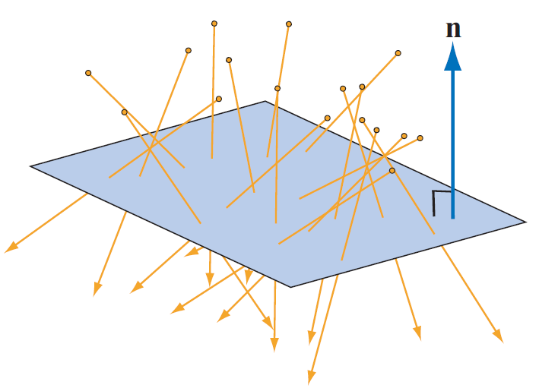
Radiant Flux and Irradiance
Radiant Flux (Power): Φ
  Radiant energy passing through a surface or region per second
  1 Watt = 1 joule/second [W]
  Size of light source and distance to receiver immaterial
Irradiance:
  Incident radiant power on a surface, per unit area
  If 50 watts of radiant power is incident on a 1.25m²
  surface, what is the irradiance at each point?

Slide 20
Radiant Exitance is Radiosity
Radiant power per unit surface area leaving a surface
  Denoted by B
What is the radiosity of a 0.1 m² light that emits 100 watts?

Slide 21
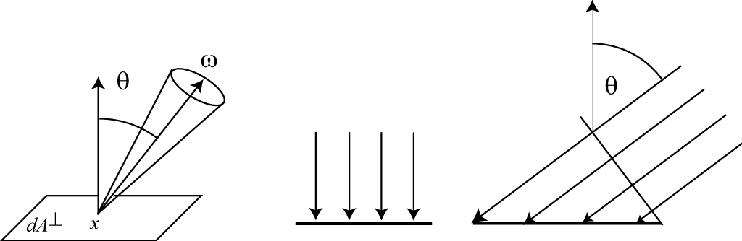
Radiance
Radiance
  flux per unit projected area per unit solid angle
  Wm⁻²sr⁻¹

Slide 22
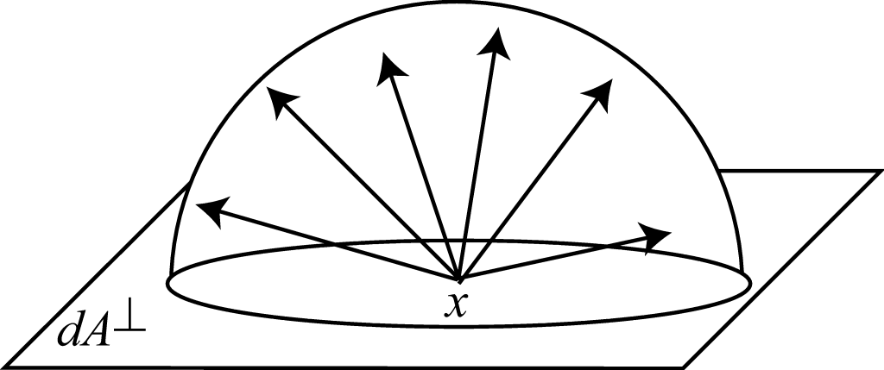
Diffuse Emitter
radiance leaving point x in directioΘ
Notes:
pi factor results from integrating cos over a hemisphere of directions
outgoing light is independent of direction
operator is component-wise multiplication
Real-time renderers include pi factor in light irradiance

Slide 23
Diffuse Emitter
radiance leaving point x in directioΘ
Ωis a hemisphere
Notes:
pi factor results from integrating cos over a hemisphere of directions
outgoing light is independent of direction
operator is component-wise multiplication
Real-time renderers include pi factor in light irradiance

Slide 24
Bidirectional Radiance Distribution Functions (BRDFs)
Precise description of surface reflectance at a point
dE_{i}(p,ω_{i}) differential amount of irradiance arriving from a solid angle
dL_{o}(p,ω_{o}) reflected radiance in the direction ω_{o}
BRDF specifies relationship between the two quantities

Slide 25
Bidirectional Radiance Distribution Functions (BRDFs)
BRDF has units of inverse steradians
Function of p and 2 directions
Range 0 to infinity
Can materials have spatially variant BRDFs?

Slide 26
Reflected Radiance
Integrate the irradiance over the whole hemisphere
Yields total reflected radiance in the ω_{o} direction
This gives us the reflection equation
What is the relation of this equation to ray-tracing?

Slide 27
Properties of BRDFs
Reciprocity
If we swap directions the value of the BRDF is unchanged
Linearity
If a material uses multiple BRDFs, the total reflected radiance will be the sum of radiances from the BRDFs
Conservation of Energy
We won’t reflect more energy than received…

Slide 28
The Rendering Equation
Expresses the steady-state radiative energy-balance in a scene
  We have emissive surafces
  And reflective surfaces
  Hemisphere form of the rendering equation
  Integration is in terms of solid angle over the hemisphere at point p
  States exitant radiance is the sum of reflected and emitted radiance

Slide 29
The Rendering Equation
Ray-tracing (and Radiosity) compute approximate solutions to the rendering equation
What is the main difficulty in computing exitant radiance form a surface?
  Depends on incoming radiance which depends on….
We can use ray-tracing to find the incoming radiance
where r_{c} is the first hit point on a ray in a given direction from p

Slide 30
The Rendering Equation
In our formulation of ray-tracing the ray
can bring back:
Radiance from a point or directional light
Nothing (background color)
Reflected light from another surface

Slide 31
The Rendering Equation
Substituting into the rendering equation we have
which has L_{o} as the only unknown
Fredholm integral equation of the second kind
  L_{o} is on both sides and inside the integral
Equation is recursive
  Why?
  What determines the recursion depth?

Slide 32
The Rendering Equation
We can also express the rendering equation in an area form
  Integral over all surfaces in a scene
V is a visibility function
G is the geometry term

Slide 33
The Rendering Equation
We re-cast the solid angle to use a surface area measure

Slide 34
Rendering Equation
Fundamental difference between are and hemisphere formulations
  Hemisphere form samples directions
  Area form has directions determined by sample points on other surfaces
Pragmatically, area form useful for direct illumination from area lights

Slide 35
Approximate Solutions
Define a linear integral operator
L_{o} is an exitant radiance distribution in solid angle at p
Operator converts L_{o} into another radiance distribution
The rendering equation can be rewritten as

Slide 36
Approximate Solutions
The rendering equation can be rewritten as
We can use repeated substitution to get
Which can be solved by simulating all light paths in a scene

Slide 37
Approximate Solutions
Ray-casting uses only the first two terms in the series
Surfaces do not reflect all light that hits them
  So a finite number of bounces can be a good approximation
For shading with point lights and perfect specular reflection the integrals educe to simple expressions
  Whitted-style ray-tracing
Path Tracing is name used to describe better solutions to the series

